Slide 1
Oracle PL/SQL
By Vivek Gohil

Slide 2
Section 1. Getting started with PL/SQL
What is PL/SQL ?
introduce you to PL/SQL programming language and its architecture.
Anonymous Block
explain PL/SQL anonymous blocks and shows you how to execute an anonymous block in SQL*Plus and Oracle SQL Developer tools.
Data Types
give you a brief overview of PL/SQL data types including number, Boolean, character, and datetime.
Variables
introduce you to PL/SQL variables and shows you how to manipulate variables in programs efficiently.

Slide 3
Section 1. Getting started with PL/SQL
Constants
learn how to declare constants that hold values that remain unchanged throughout the execution of the program.

Slide 4
What is PL/SQL ?
PL/SQL stands for “Procedural Language extensions to the Structured Query Language”.
PL/SQL adds many procedural constructs to SQL language to overcome some limitations of SQL. Besides, PL/SQL provides a more comprehensive programming language solution for building mission-critical applications on Oracle Databases.
PL/SQL is a high-performance and highly integrated database language. Besides PL/SQL, you can use other programming languages such as Java, C#, and C++.
However, it is easier to write efficient code in PL/SQL than other programming languages when it comes to interacting with the Oracle Database.
In particular, you can use PL/SQL specific constructs like the FORALL statement that helps improve database performance.

Slide 5
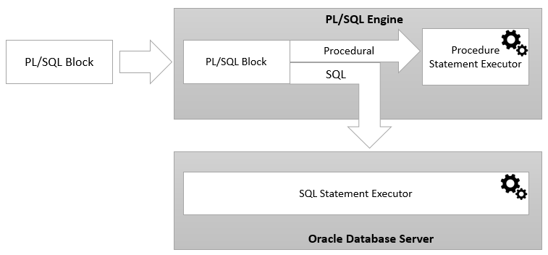
PL/SQL architecture
PL/SQL engine is in charge of compiling PL/SQL code into byte-code and executes the executable code.
Once you submit a PL/SQL block to the Oracle Database server, the PL/SQL engine collaborates with the SQL engine to compile and execute the code. PL/SQL engine runs the procedural elements while the SQL engine processes the SQL statements.

Slide 6
PL/SQL Anonymous Block
PL/SQL is a block-structured language whose code is organized into blocks.
A PL/SQL block consists of three sections: declaration, executable, and exception-handling sections.
In a block, the executable section is mandatory while the declaration and exception-handling sections are optional.
A PL/SQL block has a name. Functions or Procedures is an example of a named block. A named block is stored into the Oracle Database server and can be reused later.
A block without a name is an anonymous block.

Slide 7
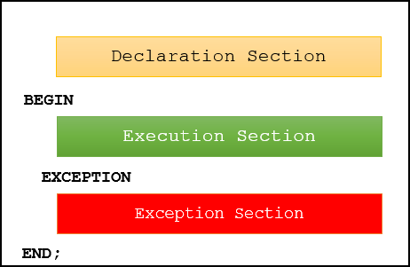
PL/SQL Anonymous Block
The following picture illustrates the structure of a PL/SQL block:
A PL/SQL block has a declaration section where you declare variables, allocate memory for cursors, and define data types.
A PL/SQL block has an executable section. An executable section starts with the keyword BEGIN and ends with the keyword END. The executable section must have a least one executable statement, even if it is the NULL statement which does nothing.
A PL/SQL block has an exception-handling section that starts with the keyword EXCEPTION. The exception-handling section is where you catch and handle exceptions raised by the code in the execution section.

Slide 8
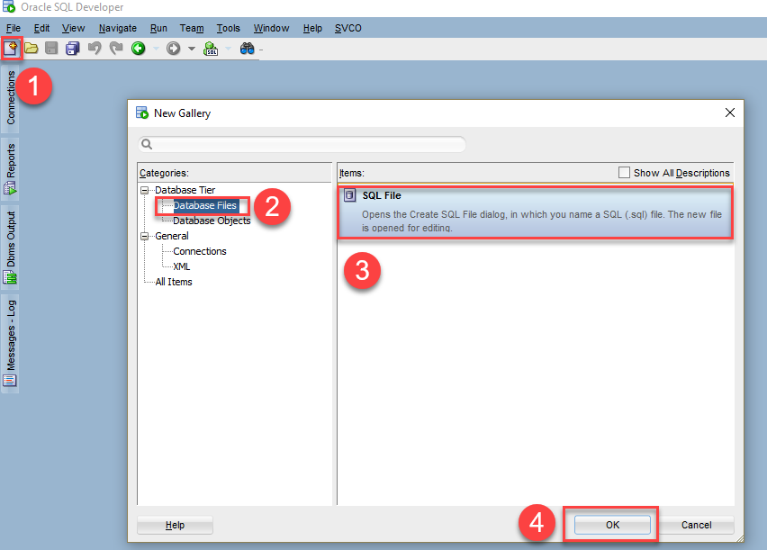
Execute a PL/SQL anonymous block using SQL Developer
First, connect to the Oracle Database server using Oracle SQL Developer.
Second, create a new SQL file named oracleplsqltraining.sql resided in the your favorite directory that will store the PL/SQL code.

Slide 9
Writing PL/SQL anonymous block example
The following example shows a simple PL/SQL anonymous block with one executable section.
BEGIN
DBMS_OUTPUT.put_line ('Hello World!');
END;
Note : that you must execute SET SERVEROUTPUT ON command in every session that you connect to the Oracle Database in order to show the message using the DBMS_OUTPUT.PUT_LINE procedure.
DECLARE
l_message VARCHAR2( 255 ) := 'Hello World!';
BEGIN
DBMS_OUTPUT.PUT_LINE( l_message );
END;

Slide 10
Writing PL/SQL anonymous block example
The next anonymous block example adds an exception-handling section which catches ZERO_DIVIDE exception raised in the executable section and displays an error message.
DECLARE
v_result NUMBER;
BEGIN
v_result := 1 / 0;
EXCEPTION
WHEN ZERO_DIVIDE THEN
DBMS_OUTPUT.PUT_LINE( SQLERRM );
END;

Slide 11
Introduction to PL/SQL data types
Each value in PL/SQL such as a constant, variable and parameter has a data type that determines the storage format, valid values, and allowed operations.
PL/SQL has two kinds of data types: scalar and composite.
The scalar types are types that store single values such as number, Boolean, character, and datetime.
Whereas the composite types are types that store multiple values, for example, record and collection.

Slide 12
PL/SQL Variables
In PL/SQL, a variable is named storage location that stores a value of a particular data type. The value of the variable changes through the program. Before using a variable, you must declare it in the declaration section of a block.
The syntax for a variable declaration is as follows:
In this syntax:
First, specify the name of the variable. The name of the variable should be as descriptive as possible, e.g., l_total_sales, l_credit_limit, and l_sales_revenue.
Second, choose an appropriate data type for the variable, depending on the kind of value which you want to store, for example, number, character, Boolean, and datetime.
variable_name datatype [NOT NULL] [:= initial_value];

Slide 13
PL/SQL Variables
By convention, local variable names should start with l_ and global variable names should have a prefix of g_ .
The following example declares three variables l_total_sales, l_credit_limit, and l_contact_name:
DECLARE
l_total_sales NUMBER(15,2);
l_credit_limit NUMBER (10,0);
l_contact_name VARCHAR2(255);
BEGIN
NULL;
END;

Slide 14
PL/SQL Variables
Default values
PL/SQL allows you to set a default value for a variable at the declaration time. To assign a default value to a variable, you use the assignment operator (:=) or the DEFAULT keyword.

Slide 15
PL/SQL Variables
The following example declares a variable named l_product_name with an initial value 'Laptop’:
It is equivalent to the following block:
DECLARE
l_product_name VARCHAR2( 100 ) := 'Laptop';
BEGIN
NULL;
END;
DECLARE
l_product_name VARCHAR2(100) DEFAULT 'Laptop';
BEGIN
NULL;
END;

Slide 16
PL/SQL Variables
NOT NULL constraint
If you impose the NOT NULL constraint on a value, then the variable cannot accept a NULL value. Besides, a variable declared with the NOT NULL must be initialized with a non-null value. Note that PL/SQL treats a zero-length string as a NULL value.

Slide 17
PL/SQL Variables
The following example first declares a variable named l_shipping_status with the NOT NULL constraint. Then, it assigns the variable a zero-length string.
DECLARE
l_shipping_status VARCHAR2( 25 ) NOT NULL := 'Shipped';
BEGIN
l_shipping_status := '';
END;
PL/SQL issued the following error: Because the variable l_shipping_status declared with the NOT NULL constraint, it could not accept a NULL value or zero-length string in this case.
ORA-06502: PL/SQL: numeric or value error

Slide 18
PL/SQL Variables
Variable assignments
To assign a value to a variable, you use the assignment operator (:=), for example:
DECLARE
l_customer_group VARCHAR2(100) := 'Silver';
BEGIN
l_customer_group := 'Gold';
DBMS_OUTPUT.PUT_LINE(l_customer_group);
END;

Slide 19
PL/SQL Variables
Anchored declarations
Typically, you declare a variable and select a value from a table column to this variable. If the data type of the table column changes, you must adjust the program to make it work with the new type.

Slide 20
PL/SQL Variables
PL/SQL allows you to declare a variable whose data type anchor to a table column or another variable. Consider the following example:
DECLARE
l_customer_name customers.name%TYPE;
l_credit_limit customers.credit_limit%TYPE;
BEGIN
SELECT
name, credit_limit
INTO
l_customer_name, l_credit_limit
FROM
customers
WHERE
customer_id = 38;
DBMS_OUTPUT.PUT_LINE(l_customer_name || ':' || l_credit_limit );
END;

Slide 21
PL/SQL Constants
Unlike a variable, a constant holds a value that does not change throughout the execution of the program.
Constants make your code more readable. Consider the following line of code that calculates the list price from price.
l_list_price := l_price + l_price * 0.1;

Slide 22
PL/SQL Constants
The following example declares two constants co_payment_term and co_payment_status:
If you attempt to change the co_payment_term in the execution section, PL/SQL will issue an error
DECLARE
co_payment_term CONSTANT NUMBER := 45; -- days
co_payment_status CONSTANT BOOLEAN := FALSE;
BEGIN
NULL;
END;
DECLARE
co_payment_term CONSTANT NUMBER := 45; -- days
co_payment_status CONSTANT BOOLEAN := FALSE;
BEGIN
co_payment_term := 30; -- error
END;

Slide 23
PL/SQL Constants
The following illustrates how to declare a constant whose value is derived from an expression:
DECLARE
co_pi CONSTANT REAL := 3.14159;
co_radius CONSTANT REAL := 10;
co_area CONSTANT REAL := (co_pi * co_radius**2);
BEGIN
DBMS_OUTPUT.PUT_LINE(co_area);
END;

Slide 24
Section 2. Conditional control
IF statements
introduce you various IF statement to either execute or skip a sequence of statements based on a condition.
CASE statements
learn how to choose one sequence of statements out of many possible sequences to execute.
GOTO
explain the GOTO statement and shows how to use it to transfer control to a labeled block or statement.
NULL statements
show you how to use the NULL statement to make the code more clearer.

Slide 25
PL/SQL IF Statement
The IF statement allows you to either execute or skip a sequence of statements, depending on a condition. The IF statement has the three forms:
IF THEN
IF THEN ELSE
IF THEN ELSIF

Slide 26
PL/SQL IF Statement
The following illustrates the structure of the IF THEN statement:
The condition is a Boolean expression that always evaluates to TRUE, FALSE, or NULL.
If the condition evaluates to TRUE, the statements after the THEN execute. Otherwise, the IF statement does nothing.
IF condition THEN
statements;
END IF;

Slide 27
PL/SQL IF Statement
PL/SQL IF THEN statement example
In the following example, the statements between THEN and END IF execute because the sales revenue is greater than 100,000.
DECLARE n_sales NUMBER := 2000000;
BEGIN
IF n_sales > 100000 THEN
DBMS_OUTPUT.PUT_LINE( 'Sales revenue is greater than 100K ' );
END IF;
END;

Slide 28
PL/SQL IF Statement
PL/SQL IF THEN ELSE statement
The IF THEN ELSE statement has the following structure:
If the condition evaluates to TRUE, then the statements between THEN and ELSE execute. In case the condition evaluates to FALSE or NULL, the else_statements between ELSE and END IF executes.
IF condition THEN
statements;
ELSE
else_statements;
END IF;

Slide 29
PL/SQL IF Statement
The following example sets the sales commission to 10% if the sales revenue is greater than 200,000. Otherwise, the sales commission is set to 5%.
DECLARE
n_sales NUMBER := 300000;
n_commission NUMBER( 10, 2 ) := 0;
BEGIN
IF n_sales > 200000 THEN
n_commission := n_sales * 0.1;
ELSE
n_commission := n_sales * 0.05;
END IF;
DBMS_OUTPUT.PUT_LINE( 'Commission : '|| n_commission );
END;

Slide 30
PL/SQL IF Statement
PL/SQL IF THEN ELSIF statement
The following example uses the IF THEN ELSIF statement to set the sales commission based on the sales revenue.
DECLARE
n_sales NUMBER := 300000;
n_commission NUMBER( 10, 2 ) := 0;
BEGIN
IF n_sales > 200000 THEN
n_commission := n_sales * 0.1;
ELSIF n_sales <= 200000 AND n_sales > 100000 THEN
n_commission := n_sales * 0.05;
ELSIF n_sales <= 100000 AND n_sales > 50000 THEN
n_commission := n_sales * 0.03;
ELSE
n_commission := n_sales * 0.02;
END IF;
DBMS_OUTPUT.PUT_LINE( 'Commission : '|| n_commission );
END;

Slide 31
PL/SQL GOTO Statement
The GOTO statement allows you to transfer control to a labeled block or statement. The following illustrates the syntax of the GOTO statement:
The label_name is the name of a label that identifies the target statement. In the program, you surround the label name with double enclosing angle brackets as shown below:
When PL/SQL encounters a GOTO statement, it transfers control to the first executable statement after the label.
GOTO label_name;
<<label_name>>;

Slide 32
PL/SQL GOTO Statement
The following shows an example of using the GOTO statements.
BEGIN
GOTO second_message;
<<first_message>>
DBMS_OUTPUT.PUT_LINE( 'Hello' );
GOTO the_end;
<<second_message>>
DBMS_OUTPUT.PUT_LINE( 'PL/SQL GOTO Demo' );
GOTO first_message;
<<the_end>>
DBMS_OUTPUT.PUT_LINE( 'and good bye...' );
END;

Slide 33
PL/SQL GOTO Statement
PL/SQL GOTO statement restrictions
First, you cannot use a GOTO statement to transfer control into an IF, CASE or LOOP statement, the same for sub-block.
The following example attempts to transfer control into an IF statement using a GOTO statement:
DECLARE
n_sales NUMBER;
n_tax NUMBER;
BEGIN
GOTO inside_if_statement;
IF n_sales > 0 THEN
<<inside_if_statement>>
n_tax := n_sales * 0.1;
END IF;
END;

Slide 34
PL/SQL NULL Statement
The PL/SQL NULL statement has the following format:
DECLARE
l_total_sales NUMBER(15,2);
l_credit_limit NUMBER (10,0);
l_contact_name VARCHAR2(255);
BEGIN
NULL;
END;

Slide 35
Section 3. Iterative processing with loops
Basic LOOP statement
show you how to use the basic LOOP statement to execute a sequence of code multiple times.
Numeric FOR LOOP statement
learn how to execute a sequence of statements a fixed number of times.
WHILE loop
execute a sequence of statements as long as a specified condition is TRUE.
CONTINUE
use the CONTINUE statement to skip the current iteration of the loop and immediately continue the next iteration.

Slide 36
PL/SQL LOOP
The PL/SQL LOOP statement has the following structure:
The LOOP statement executes the statements in its body and returns control to the top of the loop. Typically, the body of the loop contains at least one EXIT or EXIT WHEN statement for terminating the loop. Otherwise, the loop becomes an infinite loop.
The EXIT statement allows you to unconditionally exit the current iteration of a loop.
<<label>> LOOP
statements;
END LOOP loop_label;
LOOP
EXIT;
END LOOP;

Slide 37
PL/SQL LOOP
Typically, you use the EXIT statement with an IF statement to terminate a loop when a condition is true:
LOOP
IF condition THEN
EXIT;
END IF;
END LOOP;

Slide 38
PL/SQL LOOP
The following example illustrates how to use the LOOP statement to execute a sequence of code and EXIT statement to terminate the loop.
DECLARE
l_counter NUMBER := 0;
BEGIN
LOOP
l_counter := l_counter + 1;
IF l_counter > 3 THEN
EXIT;
END IF;
dbms_output.put_line( 'Inside loop: ' || l_counter ) ;
END LOOP;
-- control resumes here after EXIT
dbms_output.put_line( 'After loop: ' || l_counter );
END;

Slide 39
PL/SQL LOOP
EXIT WHEN statement
The EXIT WHEN statement exits the current iteration of a loop when the condition in the WHEN clause is TRUE. Essentially, the EXIT WHEN statement is a combination of an EXIT and an IF THEN statement.
Each time the control reaches the EXIT WHEN statement, the condition is evaluated. If the condition evaluates to TRUE, then the loop terminates. Otherwise, the EXIT WHEN clause does nothing. Inside the loop body, you must make the condition TRUE at some point to prevent an infinite loop.

Slide 40
PL/SQL LOOP
The following example uses the EXIT WHEN statement to terminate a loop.
DECLARE
l_counter NUMBER := 0;
BEGIN
LOOP
l_counter := l_counter + 1;
EXIT WHEN l_counter > 3;
dbms_output.put_line( 'Inside loop: ' || l_counter ) ;
END LOOP;
-- control resumes here after EXIT
dbms_output.put_line( 'After loop: ' || l_counter );
END;
Notice that this example is logically equivalent to the example that uses the EXIT statement above.

Slide 41
PL/SQL LOOP
Nested loops
DECLARE
l_i NUMBER := 0;
l_j NUMBER := 0;
BEGIN
<<outer_loop>>
LOOP
l_i := l_i + 1;
EXIT outer_loop WHEN l_i > 2;
dbms_output.put_line('Outer counter ' || l_i);
-- reset inner counter
l_j := 0;
<<inner_loop>> LOOP
l_j := l_j + 1;
EXIT inner_loop WHEN l_j > 3;
dbms_output.put_line(' Inner counter ' || l_j);
END LOOP inner_loop;
END LOOP outer_loop;
END;

Slide 42
PL/SQL FOR LOOP
Introduction to PL/SQL FOR LOOP statement
PL/SQL FOR LOOP executes a sequence of statements a specified number of times. The PL/SQL FOR LOOP statement has the following structure:
FOR index IN lower_bound .. upper_bound
LOOP
statements;
END LOOP;

Slide 43
PL/SQL FOR LOOP
Simple PL/SQL FOR LOOP example
In this example, the loop index is l_counter, lower_bound is one, and upper_bound is five. The loop shows a list of integers from 1 to 5.
BEGIN
FOR l_counter IN 1..5
LOOP
DBMS_OUTPUT.PUT_LINE( l_counter );
END LOOP;
END;

Slide 44
PL/SQL FOR LOOP
FOR LOOP with REVERSE keyword
The following shows the structure of the FOR LOOP statement with REVERSE keyword:
FOR index IN REVERSE lower_bound .. upper_bound
LOOP
statements;
END LOOP;

Slide 45
PL/SQL FOR LOOP
Example
BEGIN
FOR l_counter IN REVERSE 1..3
LOOP
DBMS_OUTPUT.PUT_LINE( l_counter );
END LOOP;
END;

Slide 46
PL/SQL WHILE Loop
Here is the syntax for the WHILE loop statement:
WHILE condition
LOOP
statements;
END LOOP;

Slide 47
PL/SQL WHILE Loop
Simple WHILE loop example
DECLARE
n_counter NUMBER := 1;
BEGIN
WHILE n_counter <= 5
LOOP
DBMS_OUTPUT.PUT_LINE( 'Counter : ' || n_counter );
n_counter := n_counter + 1;
END LOOP;
END;

Slide 48
PL/SQL WHILE Loop
The following example is the same as the one previous except that it has an additional EXITWHEN statement.
DECLARE
n_counter NUMBER := 1;
BEGIN
WHILE n_counter <= 5
LOOP
DBMS_OUTPUT.PUT_LINE( 'Counter : ' || n_counter );
n_counter := n_counter + 1;
EXIT WHEN n_counter = 3;
END LOOP;
END;

Slide 49
PL/SQL CONTINUE
The CONTINUE statement allows you to exit the current loop iteration and immediately continue on to the next iteration of that loop.
The CONTINUE statement has a simple syntax:
Typically, the CONTINUE statement is used within an IF THEN statement to exit the current loop iteration based on a specified condition as shown below:
CONTINUE;
IF condition THEN
CONTINUE;
END IF;

Slide 50
PL/SQL CONTINUE
The following is a simple example of using the CONTINUE statement to skip over loop body execution for odd numbers:
BEGIN
FOR n_index IN 1 .. 10
LOOP
-- skip odd numbers
IF MOD( n_index, 2 ) = 1 THEN
CONTINUE;
END IF;
DBMS_OUTPUT.PUT_LINE( n_index );
END LOOP;
END;

Slide 51
PL/SQL CONTINUE
PL/SQL CONTINUE WHEN statement
The CONTINUE WHEN statement exits the current loop iteration based on a condition and immediately continue to the next iteration of that loop.
The syntax of CONTINUE WHEN statement is:
CONTINUE WHEN condition;

Slide 52
PL/SQL CONTINUE
The following example illustrates how to use the CONTINUE WHEN statement to skip over loop body execution for even numbers:
BEGIN
FOR n_index IN 1 .. 10
LOOP
-- skip even numbers
CONTINUE
WHEN MOD( n_index, 2 ) = 0;
DBMS_OUTPUT.PUT_LINE( n_index );
END LOOP;
END;

Slide 53
Section 4. Select Into
SELECT INTO
learn how to fetch a single row from a table into variables

Slide 54
PL/SQL SELECT INTO
PL/SQL SELECT INTO statement is the simplest and fastest way to fetch a single row from a table into variables. The following illustrates the syntax of the PL/SQL SELECT INTO statement:
SELECT
select_list
INTO
variable_list
FROM
table_name
WHERE
condition;

Slide 55
PL/SQL SELECT INTO
Let’s use the customers table in the sample database for demonstration.
The following example uses a SELECT INTO statement to get the name of a customer based on the customer id, which is the primary key of the customers table.
DECLARE
l_customer_name customers.name%TYPE;
BEGIN
-- get name of the customer 100 and assign it to l_customer_name
SELECT name INTO l_customer_name
FROM customers
WHERE customer_id = 100;
-- show the customer name
dbms_output.put_line(l_customer_name);
END;

Slide 56
PL/SQL SELECT INTO
The following example fetches the entire row from the customers table for a specific customer ID:
DECLARE
r_customer customers%ROWTYPE;
BEGIN
-- get the information of the customer 100
SELECT * INTO r_customer
FROM customers
WHERE customer_id = 100;
-- show the customer info
dbms_output.put_line( r_customer.name || ', website: ' || r_customer.website );
END;

Slide 57
Section 5. Exception handlers
Exception
show you how to handle exceptions in a block.
Raise exceptions
learn how to raise an exception explicitly with the RAISE statement.
Using raise_application_error
raise an exception with a user-defined error message.
Exception propagation
learn about how PL/SQL propagates an unhandled exception from the current block to its enclosing block.
Handling other unhandled exceptions
show you how to use the SQLCODE and SQLERRM functions to handle other unhandled exceptions.

Slide 58
PL/SQL Exception
PL/SQL treats all errors that occur in an anonymous block, procedure, or function as exceptions. The exceptions can have different causes such as coding mistakes, bugs, even hardware failures.
It is not possible to anticipate all potential exceptions, however, you can write code to handle exceptions to enable the program to continue running as normal.
The code that you write to handle exceptions is called an exception handler.
A PL/SQL block can have an exception-handling section, which can have one or more exception handlers.

Slide 59
PL/SQL Exception
Here is the basic syntax of the exception-handling section:
BEGIN
-- executable section
...
-- exception-handling section
EXCEPTION
WHEN e1 THEN
-- exception_handler1
WHEN e2 THEN
-- exception_handler1
WHEN OTHERS THEN
-- other_exception_handler
END;

Slide 60
PL/SQL Exception
PL/SQL NO_DATA_FOUND exception example : The following block accepts a customer id as an input and returns the customer name :
DECLARE
l_name customers.NAME%TYPE;
l_customer_id customers.customer_id%TYPE := &customer_id;
BEGIN
-- get the customer name by id
SELECT name INTO l_name
FROM customers
WHERE customer_id = l_customer_id;
-- show the customer name
dbms_output.put_line('Customer name is ' || l_name);
END;
/
If you execute the block and enter the customer id as zero, Oracle will issue the following error:
ORA-01403: no data found

Slide 61
PL/SQL Exception
To issue a more meaningful message, you can add an exception-handling section as follows:
DECLARE
l_name customers.NAME%TYPE;
l_customer_id customers.customer_id%TYPE := &customer_id;
BEGIN
-- get the customer
SELECT NAME INTO l_name
FROM customers
WHERE customer_id = l_customer_id;
-- show the customer name
dbms_output.put_line('customer name is ' || l_name);
EXCEPTION
WHEN NO_DATA_FOUND THEN
dbms_output.put_line('Customer ' || l_customer_id || ' does not exist');
END;

Slide 62
PL/SQL Exception
PL/SQL TOO_MANY_ROWS exception example : First, modify the code block in the above example as follows and execute it:
DECLARE
l_name customers.name%TYPE;
l_customer_id customers.customer_id%TYPE := &customer_id;
BEGIN
-- get the customer
SELECT name INTO l_name
FROM customers
WHERE customer_id <= l_customer_id;
-- show the customer name
dbms_output.put_line('Customer name is ' || l_name);
EXCEPTION
WHEN NO_DATA_FOUND THEN
dbms_output.put_line('Customer ' || l_customer_id || ' does not exist');
END;
Second, enter the customer id 10 and you’ll get the following error:
ORA-01422: exact fetch returns more than requested number of rows

Slide 63
PL/SQL Exception
DECLARE
l_name customers.NAME%TYPE;
l_customer_id customers.customer_id%TYPE := &customer_id;
BEGIN
-- get the customer
SELECT NAME INTO l_name
FROM customers
WHERE customer_id > l_customer_id;
-- show the customer name
dbms_output.put_line('Customer name is ' || l_name);
EXCEPTION
WHEN NO_DATA_FOUND THEN
dbms_output.put_line('Customer ' || l_customer_id || ' does not exist');
WHEN TOO_MANY_ROWS THEN
dbms_output.put_line('The database returns more than one customer');
END;

Slide 64
PL/SQL Exception
List Of Predefined exceptions : Link
https://docs.oracle.com/cd/B10501_01/appdev.920/a96624/07_errs.htm

Slide 65
PL/SQL Raise Exceptions
To raise an exception explicitly, you use the RAISE statement. The RAISE statement allows you to:
Raise a user-defined exception.
Raise an internally defined exception.
Reraising the current exception.

Slide 66
PL/SQL Raise Exceptions
Raising a user-defined exception
A user-defined exception is defined by users like you or other developers in the declaration section of a block or subprogram.
Declaring a user-defined exception
To define a user-defined exception, you use the following syntax:
A user-defined exception must have assigned error_code . To do it, you use the EXCEPTION_INIT pragma as follows:
In this syntax, the error_code is an integer that ranges from -20,999 to -20,000. And the message is a character string with a maximum length of 2,048 bytes.
DECLARE
exception_name EXCEPTION;
PRAGMA EXCEPTION_INIT (exception_name, error_code)

Slide 67
PL/SQL Raise Exceptions
The entire syntax for declaring a user-defined exception is as follows:
DECLARE
exception_name EXCEPTION;
PRAGMA EXCEPTION_INIT (exception_name, error_number);

Slide 68
PL/SQL Raise Exceptions
DECLARE
e_credit_too_high EXCEPTION;
PRAGMA exception_init( e_credit_too_high, -20001 );
l_max_credit customers.credit_limit%TYPE;
l_customer_id customers.customer_id%TYPE := &customer_id;
l_credit customers.credit_limit%TYPE := &credit_limit;
BEGIN
-- get the meax credit limit
SELECT MAX(credit_limit)
INTO l_max_credit
FROM customers;
-- check if input credit is greater than the max credit
IF l_credit > l_max_credit THEN
RAISE e_credit_too_high;
END IF;
-- if not, update credit limit
UPDATE customers
SET credit_limit = l_credit
WHERE customer_id = l_customer_id;
COMMIT;
END;
Here is the output if you enter customer id 100 and credit limit 20000:

Slide 69
PL/SQL Raise Exceptions
If you want to include a custom message, you can replace the line:
by the following line:
And execute the code block again, you will receive the following error:
RAISE e_credit_too_high;
raise_application_error(-20001,'Credit is too high');
ORA-20001: Credit is too high

Slide 70
PL/SQL Exception Propagation
When an exception occurs, PL/SQL looks for an exception handler in the current block e.g., anonymous block, procedure, or function of the exception.
If it does not find a match, PL/SQL propagates the exception to the enclosing block of the current block.
PL/SQL then attempts to handle the exception by raising it once more in the enclosing block.
This process continues in each successive enclosing block until there is no remaining block in which to raise the exception.
If there is no exception handler in all blocks, PL/SQL returns an unhandled exception to the application environment that executed the outermost PL/SQL block.

Slide 71
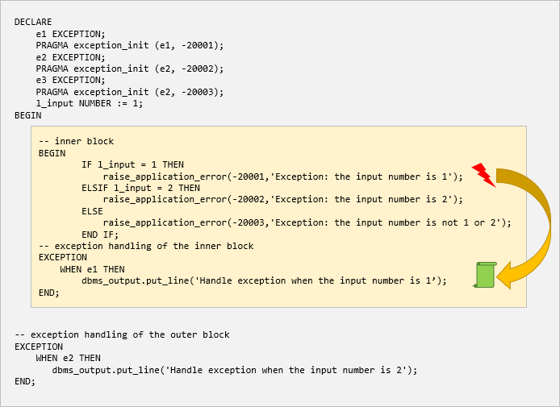
PL/SQL Exception Propagation
Unhandled exception propagation examples

Slide 72
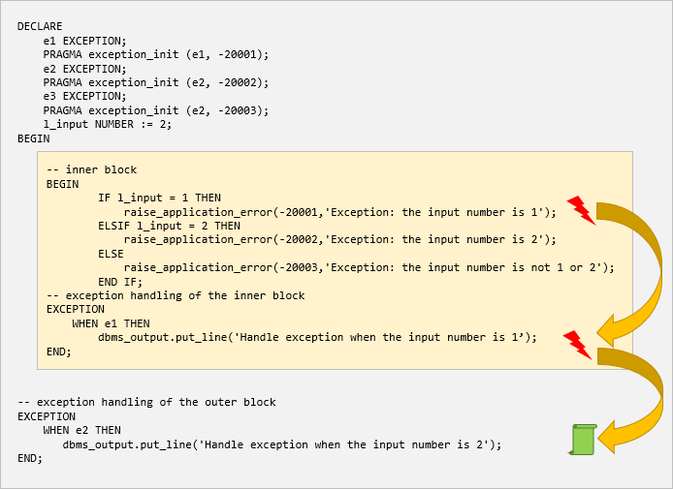
PL/SQL Exception Propagation

Slide 73
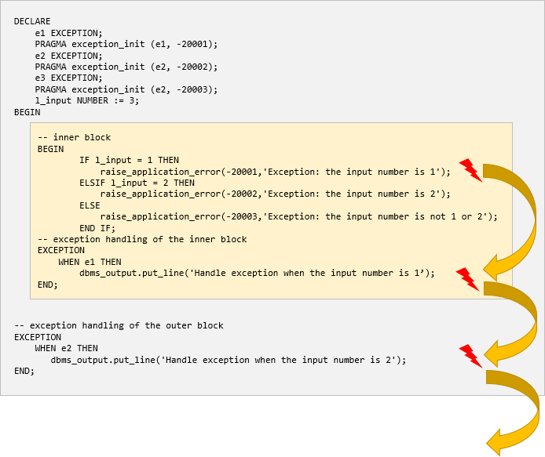
PL/SQL Exception Propagation

Slide 74
Handling Other Unhandled Exceptions
In this exception handling section, you can include the WHEN OTHERS clause to catch any otherwise unhandled exceptions:
Because you handle other non-specific exceptions in the WHEN OTHERS clause, you will need to take advantages of the built-in error functions such as SQLCODE and SQLERRM
EXCEPTION
...
WHEN OTHERS
-- catch other exceptions

Slide 75
Handling Other Unhandled Exceptions
SQLCODE function
The SQLCODE function accepts no argument and returns a number code of the most recent exception.
If the exceptions are internal, SQLCODE returns a negative number except for the NO_DATA_FOUND exception which has the number code +100.
If the exception is user-defined, SQLCODE returns +1 or the number that you associated with the exception via the pragma EXCEPTION_INIT.
The SQLCODE is only usable in the exception-handling section. If you use the SQLCODE function outside an exception handler, it always returns zero.

Slide 76
Handling Other Unhandled Exceptions
This example illustrates how to use the SQLCODE function:
DECLARE
l_code NUMBER;
r_customer customers%rowtype;
BEGIN
SELECT * INTO r_customer FROM customers;
EXCEPTION
WHEN OTHERS THEN
l_code := SQLCODE;
dbms_output.put_line('Error code:' || l_code);
END;
/

Slide 77
Handling Other Unhandled Exceptions
SQLERRM function
In this syntax, the error_number can be any valid Oracle error number.
If you omit the error_number argument, the function will return the error message associated with the current value of SQLCODE.
Note that the SQLERRM function with no argument is only useful in an exception handler.

Slide 78
Handling Other Unhandled Exceptions
This example illustrates how to use the function SQLERRM in an exception handler:
DECLARE
l_msg VARCHAR2(255);
r_customer customers%rowtype;
BEGIN
SELECT * INTO r_customer FROM customers;
EXCEPTION
WHEN OTHERS THEN
l_msg := SQLERRM;
dbms_output.put_line(l_msg);
END;
/

Slide 79
Section 6. Records
Record
learn how to use record type to make your code more efficiently by shifting operations from field-level to record-level.

Slide 80

PL/SQL Record
A PL/SQL record is a composite data structure which consists of multiple fields; each has its own value.
The following picture shows an example record that includes first name, last name, email, and phone number:
PL/SQL record helps you simplify your code by shifting from field-level to record-level operations.

Slide 81
PL/SQL Record
PL/SQL has three types of records:
table-based
cursor-based
programmer-defined
Before using a record, you must declare it.

Slide 82
PL/SQL Record
Table-based record
To declare a table-based record, you use the %ROWTYPE attribute with a table name. A table-based record has each field corresponding to a column in a table.
The following example declares a record named r_contact with the same structure as the contacts table in the sample database:
DECLARE
record_name table_name%ROWTYPE;
DECLARE
r_contact contacts%ROWTYPE;

Slide 83
PL/SQL Record
Cursor-based record
A cursor-based record has each field corresponding a column or alias in the cursor SELECT statement.
To declare a cursor-based record, you use the %ROWTYPE attribute with an explicit cursor as shown below:
The following example declares a record with the same structure as an explicit cursor:
DECLARE
record_name cursor_name%ROWTYPE;
DECLARE
CURSOR c_contacts IS
SELECT first_name, last_name, phone
FROM contacts;
r_contact c_contacts%ROWTYPE;

Slide 84
PL/SQL Record
Programmer-defined record
The table-based and cursor-based records are good enough when you need to create records based on existing structures.
If you want to create a record whose structure is not based on the existing ones, then you use programmer-defined record.
To declare a programmer-defined record, you use the following steps:
Define a record type that contains the structure you want in your record.
Declare a record based on the record type.

Slide 85
PL/SQL Record
The following example defines a record type whose name is r_employee_details and a record whose type is r_employee_details_t:
DECLARE
-- define a record type
TYPE r_employee_details_t IS RECORD (
employee_id employee_details.employee_id%TYPE,
first_name employee_details.first_name%TYPE,
last_name employee_details.last_name%TYPE
);
-- declare a record
r_employee_details r_employee_details_t;
BEGIN
SELECT
employee_id,
first_name,
last_name
INTO r_employee_details
FROM
employee_details
WHERE
employee_id = 101;
dbms_output.put_line(r_employee_details.employee_id);
dbms_output.put_line(r_employee_details.first_name);
dbms_output.put_line(r_employee_details.last_name);
END;
/

Slide 86
Section 7. Cursors
Cursor
introduce you to cursors including implicit and explicit cursors and shows you how to use them effectively to fetch data from a table.
Cursor FOR LOOP
show you how to use the cursor FOR LOOP statement to fetch and process each row from a cursor.
Cursor with parameters
learn how to use the cursor with parameters to fetch data according to the input arguments passed to the cursor each time it is opened.
Cursor Variables with REF CURSOR
guide you on how to use the cursor variable with ref cursor.
Updatable cursor
introduce you to the Oracle updatable cursor to update data in the table.

Slide 87
PL/SQL Cursor
A cursor is a pointer that points to a result of a query.
PL/SQL has two types of cursors:
implicit cursors
explicit cursors

Slide 88
PL/SQL Cursor
Implicit cursors
Whenever Oracle executes an SQL statement such as SELECT INTO, INSERT, UPDATE, and DELETE, it automatically creates an implicit cursor.
Oracle internally manages the whole execution cycle of implicit cursors and reveals only the cursor’s information and statuses such as SQL%ROWCOUNT, SQL%ISOPEN, SQL%FOUND, and SQL%NOTFOUND.
The implicit cursor is not elegant when the query returns zero or multiple rows which cause NO_DATA_FOUND or TOO_MANY_ROWS exception respectively.

Slide 89
PL/SQL Cursor
Explicit cursors
An explicit cursor is an SELECT statement declared explicitly in the declaration section of the current block or a package specification.
For an explicit cursor, you have control over its execution cycle from OPEN, FETCH, and CLOSE.
Oracle defines an execution cycle that executes an SQL statement and associates a cursor with it.

Slide 90
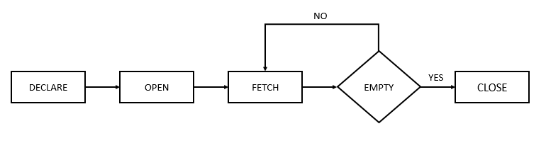
PL/SQL Cursor
The following illustration shows the execution cycle of an explicit cursor:

Slide 91
PL/SQL Cursor
Declare a cursor
Before using an explicit cursor, you must declare it in the declaration section of a block or package as follows:
In this syntax:
First, specify the name of the cursor after the CURSOR keyword.
Second, define a query to fetch data after the IS keyword.
CURSOR cursor_name IS query;

Slide 92
PL/SQL Cursor
Open a cursor
Before start fetching rows from the cursor, you must open it. To open a cursor, you use the following syntax:
In this syntax, the cursor_name is the name of the cursor declared in the declaration section.
When you open a cursor, Oracle parses the query, binds variables, and executes the associated SQL statement.
Oracle also determines an execution plan, associates host variables and cursor parameters with the placeholders in the SQL statement, determines the result set, and sets the cursor to the first row in the result set.
OPEN cursor_name;

Slide 93
PL/SQL Cursor
Fetch from a cursor
The FETCH statement places the contents of the current row into variables. The syntax of FETCH statement is as follows:
To retrieve all rows in a result set, you need to fetch each row till the last one.
FETCH cursor_name INTO variable_list;

Slide 94
PL/SQL Cursor
Closing a cursor
After fetching all rows, you need to close the cursor with the CLOSE statement:
Closing a cursor instructs Oracle to release allocated memory at an appropriate time.
If you declare a cursor in an anonymous block, procedure, or function, the cursor will automatically be closed when the execution of these objects end.
CLOSE cursor_name;

Slide 95
PL/SQL Cursor
Explicit Cursor Attributes
%ISOPEN
This attribute is TRUE if the cursor is open or FALSE if it is not.
%FOUND
This attribute has four values:
NULL before the first fetch
TRUE if a record was fetched successfully
FALSE if no row returned
INVALID_CURSOR if the cursor is not opened
%NOTFOUND
This attribute has four values:
NULL before the first fetch
FALSE if a record was fetched successfully
TRUE if no row returned
INVALID_CURSOR if the cursor is not opened

Slide 96
PL/SQL Cursor
Explicit Cursor Attributes
%ROWCOUNT
The %ROWCOUNT attribute returns the number of rows fetched from the cursor. If the cursor is not opened, this attribute returns INVALID_CURSOR.

Slide 97
PL/SQL Cursor
Cursor attributes example
DECLARE
CURSOR c_employee IS SELECT * FROM employee;
r_employee c_employee%ROWTYPE;
BEGIN
-- open the cursor if it is not open
IF NOT c_employee%ISOPEN THEN
OPEN c_employee;
END IF;
-- fetch data from curso into the rowtype variable
FETCH c_employee INTO r_employee;
-- keep fetching until no more records are found
WHILE c_employee%FOUND
LOOP
DBMS_OUTPUT.put_line('Just fetched record number '|| to_char(c_employee%ROWCOUNT));
-- fetch data from curso into the rowtype variable
FETCH c_employee INTO r_employee;
END LOOP;
END;

Slide 98
PL/SQL Cursor FOR LOOP
The cursor FOR LOOP statement is an elegant extension of the numeric FOR LOOP statement.
The numeric FOR LOOP executes the body of a loop once for every integer value in a specified range.
Similarly, the cursor FOR LOOP executes the body of the loop once for each row returned by the query associated with the cursor.
A nice feature of the cursor FOR LOOP statement is that it allows you to fetch every row from a cursor without manually managing the execution cycle i.e., OPEN, FETCH, and CLOSE.

Slide 99
PL/SQL Cursor FOR LOOP
PL/SQL cursor FOR LOOP example
DECLARE
CURSOR c_employee IS
SELECT
id,
first_name,
last_name
FROM
employee;
BEGIN
FOR r_employee IN c_employee LOOP
dbms_output.put_line(r_employee.id);
dbms_output.put_line(r_employee.first_name);
dbms_output.put_line(r_employee.last_name);
END LOOP;
END;

Slide 100
PL/SQL Cursor with Parameters
An explicit cursor may accept a list of parameters. Each time you open the cursor, you can pass different arguments to the cursor, which results in different result sets.
The following shows the syntax of a declaring a cursor with parameters:
To open a cursor with parameters, you use the following syntax:
CURSOR cursor_name (parameter_list)
IS
cursor_query;
OPEN cursor_name (value_list);

Slide 101
PL/SQL Cursor with Parameters
The following example illustrates how to use a cursor with parameters:
DECLARE
CURSOR c_employee(p_description employee.description%TYPE) IS SELECT * FROM employee WHERE description = p_description;
r_employee c_employee%ROWTYPE;
BEGIN
-- open the cursor if it is not open
IF NOT c_employee%ISOPEN THEN
OPEN c_employee('&description');
END IF;
-- fetch data from curso into the rowtype variable
FETCH c_employee INTO r_employee;
-- keep fetching until no more records are found
WHILE c_employee%FOUND
LOOP
-- DBMS_OUTPUT.put_line('Just fetched record number '|| to_char(c_employee%ROWCOUNT));
DBMS_OUTPUT.put_line(r_employee.id );
-- fetch data from curso into the rowtype variable
FETCH c_employee INTO r_employee;
END LOOP;
END;
/

Slide 102
PL/SQL Cursor Variables with REF CURSOR
A cursor variable is a variable that references to a cursor.
Different from implicit and explicit cursors, a cursor variable is not tied to any specific query. Meaning that a cursor variable can be opened for any query.
The most important benefit of a cursor variable is that it enables passing the result of a query between PL/SQL programs.

Slide 103
PL/SQL Cursor Variables with REF CURSOR
CREATE OR REPLACE FUNCTION getallproducts RETURN SYS_REFCURSOR IS
refcursorvalue SYS_REFCURSOR;
BEGIN
OPEN refcursorvalue FOR SELECT * FROM product;
RETURN ( refcursorvalue );
END;
DECLARE
refcursorvalue SYS_REFCURSOR;
myrecord product%rowtype;
BEGIN
refcursorvalue := getallproducts;
LOOP
FETCH refcursorvalue INTO myrecord;
EXIT WHEN refcursorvalue%notfound;
dbms_output.put_line(to_char(myrecord.product_id) || ' '|| myrecord.product_description);
END LOOP;
EXCEPTION
WHEN OTHERS THEN
dbms_output.put_line(to_char(sqlcode)|| ' '|| sqlerrm);
END;

Slide 104
Section 8. Stored procedures and Functions
Procedure
a step-by-step guide to create, compile and execute a procedure from Oracle SQL Developer.
Implicit statement results
learn how to return one or more result sets from a procedure.
Function
show you how to develop a PL/SQL function and explain to you various ways to call a function.
Cursor variables
learn how to use cursor variables using REF CURSOR type.

Slide 105
PL/SQL Procedure
A PL/SQL procedure is a reusable unit that encapsulates specific business logic of the application.
Technically speaking, a PL/SQL procedure is a named block stored as a schema object in the Oracle Database.

Slide 106
PL/SQL Procedure
PL/SQL procedure header
A procedure begins with a header that specifies its name and an optional parameter list.
Each parameter can be in either IN, OUT, or INOUT mode. The parameter mode specifies whether a parameter can be read from or write to.
IN
An IN parameter is read-only. You can reference an IN parameter inside a procedure, but you cannot change its value. Oracle uses IN as the default mode. It means that if you don’t specify the mode for a parameter explicitly, Oracle will use the IN mode.
OUT
An OUT parameter is writable. Typically, you set a returned value for the OUT parameter and return it to the calling program. Note that a procedure ignores the value that you supply for an OUT parameter.

Slide 107
PL/SQL Procedure
PL/SQL procedure header
INOUT
An INOUT parameter is both readable and writable. The procedure can read and modify it.
Note that OR REPLACE option allows you to overwrite the current procedure with the new code.

Slide 108
PL/SQL Procedure
PL/SQL procedure body
Like an anonymous block, the procedure body has three parts. The executable part is mandatory whereas the declarative and exception-handling parts are optional. The executable part must contain at least one executable statement.
Declarative part
In this part, you can declare variables, constants, cursors, etc. Unlike an anonymous block, a declaration part of a procedure does not start with the DECLARE keyword.
Executable part
This part contains one or more statements that implement specific business logic. It might contain only a NULL statement.
Exception-handling part
This part contains the code that handles exceptions.

Slide 109
PL/SQL Procedure
Creating a PL/SQL procedure example
The following procedure accepts a employee id and prints out the employee’s information including first name, last name, and salary:
CREATE OR REPLACE PROCEDURE print_employee(in_employee_id NUMBER )
IS
r_employee employee_details%ROWTYPE;
BEGIN
-- get employee based on employee id
SELECT *
INTO r_employee
FROM employee_details
WHERE employee_id = in_employee_id;
-- print out employee's information
dbms_output.put_line( r_employee.first_name || ' ' || r_employee.last_name || '<' || r_employee.salary ||'>' );
EXCEPTION
WHEN OTHERS THEN
dbms_output.put_line( SQLERRM );
END;

Slide 110
PL/SQL Procedure
Oracle Implicit Statement Results
Prior Oracle Database 12c, you can return a result set from a stored procedure using the OUT REF CURSOR parameters.
To make the migration of other databases to the Oracle Database easier, Oracle Database 12c Release 1 added a new feature called implicit statement result that allows you to return one or more result sets from a stored procedure by using the dbms_sql package.

Slide 111
PL/SQL Procedure
Returning a single result set
The following statement creates a stored procedure that returns employee details who have salary are greater than a specific salary:
CREATE OR REPLACE PROCEDURE get_employee_by_salary(min_salary NUMBER)
AS
c_employee SYS_REFCURSOR;
BEGIN
-- open the cursor
OPEN c_employee FOR
SELECT employee_id, salary, first_name
FROM employee_details
WHERE salary > min_salary
ORDER BY salary;
-- return the result set
dbms_sql.return_result(c_employee);
END;
-- To test the stored procedure, you can execute it as follows:
EXEC get_employee_by_salary(500);

Slide 112
PL/SQL Procedure
Returning multiple result sets
The following statement creates a stored procedure that returns the customer result set by pages specified by page no and page size. On top of that, it returns the total rows of the customers table.

Slide 113
PL/SQL Procedure
CREATE OR REPLACE PROCEDURE get_employee_data (in_id IN employee.id%TYPE ,
out_first_name OUT employee.first_name%TYPE , out_last_name OUT employee.last_name%TYPE )
AS
CURSOR c_employee (id employee.id%TYPE) IS
SELECT first_name , last_name FROM employee
WHERE id = id;
first_name employee.first_name%TYPE;
last_name employee.last_name%TYPE;
BEGIN
-- open the cursor if it is not open
IF NOT c_employee%isopen THEN
OPEN c_employee(in_id);
END IF;
-- fetch data from curso into the rowtype variable
FETCH c_employee INTO first_name,last_name;
out_first_name := first_name;
out_last_name := last_name;
-- close the cursor
CLOSE c_employee;
END;
/

Slide 114
PL/SQL Procedure
DECLARE
id employee.id%TYPE;
first_name employee.first_name%TYPE;
last_name employee.last_name%TYPE;
BEGIN
id := '01';
get_employee_data(id, first_name , last_name);
dbms_output.put_line(first_name);
dbms_output.put_line(last_name);
END;

Slide 115
PL/SQL Function
Creating a PL/SQL function
Like a procedure, a PL/SQL function is a reusable program unit stored as a schema object in the Oracle Database
A function consists of a header and body.
The function header has the function name and a RETURN clause that specifies the datatype of the returned value. Each parameter of the function can be either in the IN, OUT, or INOUT mode.

Slide 116
PL/SQL Function
The following example creates a function that calculates total salary by designation.
CREATE OR REPLACE FUNCTION get_total_salary(in_designation VARCHAR)
RETURN NUMBER
IS
l_total_salary NUMBER := 0;
BEGIN
-- get total sales
SELECT SUM(salary)
INTO l_total_salary
FROM employee_details
WHERE designation = in_designation;
-- return the total sales
RETURN l_total_salary ;
END;

Slide 117
PL/SQL Function
Calling a PL/SQL function
-- 1) in an assignment statement:
DECLARE
l_total_salary_manager NUMBER := 0;
BEGIN
l_total_salary_manager := get_total_salary ('manager');
DBMS_OUTPUT.PUT_LINE('Total Salary of Managers: ' || l_total_salary_manager);
END;
/
-- 2) in a Boolean expression
BEGIN
IF get_total_salary ('manager') > 2000 THEN
DBMS_OUTPUT.PUT_LINE('Your message');
END IF;
END;
/

Slide 118
PL/SQL Function
-- 3) in an SQL statement
SELECT
get_total_salary('manager')
FROM
dual;

Slide 119
Section 10. Triggers
Triggers
introduce you to the Oracle trigger and show you how to create a new trigger.
Statement-level triggers
learn how to use statement-level triggers to enforce additional security to the transaction.
Row-level triggers
show you how to use row-level triggers for data-related activities.
Disable triggers
show you to disable a trigger or all triggers of a table.
Enable triggers
describe steps to enable a trigger or all triggers of a table.
Drop Triggers
guide you on how to drop a trigger from the database.

Slide 120
Oracle Trigger
What is an Oracle trigger
A trigger is a named PL/SQL block stored in the Oracle Database and executed automatically when a triggering event takes place.
A data manipulation language (DML) statement executed against a table e.g., INSERT, UPDATE, or DELETE. For example, if you define a trigger that fires before an INSERT statement on the customers table, the trigger will fire once before a new row is inserted into the customers table.
A data definition language (DDL) statement executes e.g., CREATE or ALTER statement. These triggers are often used for auditing purposes to record changes of the schema.
A system event such as startup or shutdown of the Oracle Database.
A user event such as login or logout.

Slide 121
Oracle Trigger
Oracle triggers are useful in many cases such as the following:
Enforcing complex business rules that cannot be established using integrity constraint such as UNIQUE, NOT NULL, and CHECK.
Preventing invalid transactions.
Gathering statistical information on table accesses.
Generating value automatically for derived columns.
Auditing sensitive data.

Slide 122
Oracle Trigger
Suppose we want to record actions against the employee table whenever an employee is updated or deleted. In order to do this:
First, create a new table for recording the UPDATE and DELETE events:
CREATE TABLE audits (
audit_id NUMBER GENERATED BY DEFAULT AS IDENTITY PRIMARY KEY,
table_name VARCHAR2(255),
transaction_name VARCHAR2(10),
by_user VARCHAR2(30),
transaction_date DATE
);

Slide 123
Oracle Statement-level Triggers
A statement-level trigger is fired whenever a trigger event occurs on a table regardless of how many rows are affected.
In other words, a statement-level trigger executes once for each transaction.
For example, if you update 1000 rows in a table, then a statement-level trigger on that table would only be executed once.

Slide 124
Oracle Statement-level Triggers
Oracle Statement-level Trigger example
CREATE OR REPLACE TRIGGER employee_salary_trg
BEFORE UPDATE OF salary
ON employee_details
DECLARE
l_day_of_month NUMBER;
BEGIN
-- determine the transaction type
l_day_of_month := EXTRACT(DAY FROM sysdate);
IF l_day_of_month BETWEEN 28 AND 31 THEN
raise_application_error(-20100,'Cannot update employee salary from 28th to 31st');
END IF;
END;

Slide 125
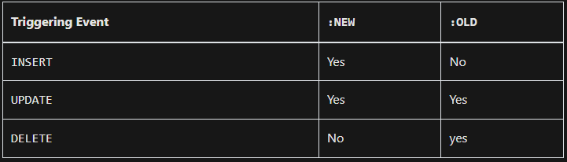
Oracle Row-level Triggers
Row-level triggers fires once for each row affected by the triggering event such as INSERT, UPDATE, or DELETE.
Row-level triggers are useful for data-related activities such as data auditing and data validation.
To create a new row-level trigger, you use the CREATE TRIGGER statement with the FOR EACH ROW clause.
This table illustrates the availability of :NEW and :OLD variables by the triggering event:

Slide 126
Oracle row-level trigger example
The following example creates a row-level trigger that prevents users from updating salary for a employee if the new salary increases to more than double:
CREATE OR REPLACE TRIGGER employee_update_salary_trg
BEFORE UPDATE OF salary
ON employee_details
FOR EACH ROW
WHEN (NEW.salary > 0)
BEGIN
-- check the credit limit
IF :NEW.salary >= 2 * :OLD.salary THEN
raise_application_error(-20101,'The new salary ' || :NEW.salary ||
' cannot increase to more than double, the current salary' || :OLD.salary);
END IF;
END;
/

Slide 127
INSTEAD OF Triggers
An INSTEAD OF trigger is a trigger that allows you to update data in tables via their view which cannot be modified directly through DML statements.

Slide 128
INSTEAD OF trigger example
We will use the customers and contacts tables from the sample database for the demonstration.
First, create a view based on the customers and contacts tables:
CREATE VIEW vw_customers AS
SELECT
name, address, website,
credit_limit,
first_name,
last_name,
email,
phone
FROM
customers
INNER JOIN contacts USING (customer_id);

Slide 129
INSTEAD OF trigger example
Next, attempt to insert a new customer and contact into the underlying tables via the view
INSERT INTO vw_customers(
name, address,
website,
credit_limit,
first_name,
last_name,
email,
phone
)
VALUES(
'Lam Research', 'Fremont, California, USA',
'https://www.lamresearch.com/',
2000,
'John',
'Smith',
'john.smith@lamresearch.com',
'+1-510-572-0200'
);

Slide 130
INSTEAD OF trigger example
Then, create an INSTEAD OF trigger on the view vw_customers:
CREATE OR REPLACE TRIGGER new_customer_trg
INSTEAD OF INSERT ON vw_customers
FOR EACH ROW
DECLARE
l_customer_id NUMBER;
BEGIN
-- insert a new customer first
INSERT INTO customers(name, address, website, credit_limit)
VALUES(:NEW.NAME, :NEW.address, :NEW.website, :NEW.credit_limit)
RETURNING customer_id INTO l_customer_id;
-- insert the contact
INSERT INTO contacts(first_name, last_name, email, phone, customer_id)
VALUES(:NEW.first_name, :NEW.last_name, :NEW.email, :NEW.phone, l_customer_id);
END;

Slide 131
Oracle Disable Triggers
Sometimes, you may want to disable a trigger for testing and troubleshooting purposes. To disable a trigger, you use the ALTER TRIGGER DISABLE statement:
Disable all triggers of a table
ALTER TRIGGER employee_audit_trg DISABLE;
ALTER TABLE employee_details DISABLE ALL TRIGGERS;

Slide 132
PL/SQL - Collections
A collection is an ordered group of elements having the same data type. Each element is identified by a unique subscript that represents its position in the collection.
PL/SQL provides below collection types
VARRAY
Nested table
Index-by tables or Associative array

Slide 133
Index-By Table
Elements of an index-by table could also be a %ROWTYPE of any database table or %TYPE of any database table field.
DECLARE
CURSOR c_customers is
select name from customers;
TYPE c_list IS TABLE of customers.Name%type INDEX BY binary_integer;
name_list c_list;
counter integer :=0;
BEGIN
FOR n IN c_customers LOOP
counter := counter +1;
name_list(counter) := n.name;
dbms_output.put_line('Customer('||counter||'):'||name_lis t(counter));
END LOOP;
END;
/

Slide 134
Nested Tables
A nested table is like a one-dimensional array with an arbitrary number of elements. However, a nested table differs from an array in the following aspects −
An array has a declared number of elements, but a nested table does not. The size of a nested table can increase dynamically.
An array is always dense, i.e., it always has consecutive subscripts. A nested array is dense initially, but it can become sparse when elements are deleted from it.

Slide 135
Nested Tables
The following examples illustrate the use of nested table
DECLARE
TYPE names_table IS TABLE OF VARCHAR2(10);
TYPE grades IS TABLE OF INTEGER;
names names_table;
marks grades;
total integer;
BEGIN
names := names_table('Kavita', 'Pritam', 'Ayan', 'Rishav', 'Aziz');
marks:= grades(98, 97, 78, 87, 92);
total := names.count;
dbms_output.put_line('Total '|| total || ' Students');
FOR i IN 1 .. total LOOP
dbms_output.put_line('Student:'||names(i)||', Marks:' || marks(i));
end loop;
END;
/

Slide 136
Nested Tables
Elements of a nested table can also be a %ROWTYPE of any database table or %TYPE of any database table field.
DECLARE
CURSOR c_customers is
SELECT name FROM customers;
TYPE c_list IS TABLE of customerS.No.ame%type;
name_list c_list := c_list();
counter integer :=0;
BEGIN
FOR n IN c_customers LOOP
counter := counter +1;
name_list.extend;
name_list(counter) := n.name;
dbms_output.put_line('Customer('||counter||'):'||name_list(counter));
END LOOP;
END;
/

Slide 137
Index-By Table
An index-by table (also called an associative array) is a set of key-value pairs. Each key is unique and is used to locate the corresponding value. The key can be either an integer or a string.

Slide 138
Index-By Table
Following example shows how to create a table to store integer values along with names and later it prints the same list of names.
DECLARE
TYPE salary IS TABLE OF NUMBER INDEX BY VARCHAR2(20);
salary_list salary;
name VARCHAR2(20);
BEGIN
-- adding elements to the table
salary_list('Rajnish') := 62000;
salary_list('Minakshi') := 75000;
salary_list('Martin') := 100000;
salary_list('James') := 78000;
-- printing the table
name := salary_list.FIRST;
WHILE name IS NOT null LOOP
dbms_output.put_line
('Salary of ' || name || ' is ' || TO_CHAR(salary_list(name)));
name := salary_list.NEXT(name);
END LOOP;
END;

